Slide 1
2: Developing a Multisensory Curriculum
2C: Multisensory Literacy
www.multisensorylearning.lgfl.net ©2018 www.hirstwood.com & London Grid for Learning

Slide 2
Literacy
Literacy is a fundamental activity in every school. Four key language skills required for literacy are:
Speaking
Listening
Reading
Writing
www.multisensorylearning.lgfl.net ©2018 www.hirstwood.com & London Grid for Learning

Slide 3
Literacy
For learners with issues such as dyslexia, multisensory learning is particularly powerful to support literacy.
There are a whole host of multisensory strategies, tools and games that can be used to help.
When considering learners with dyslexia it is key that structured, sequential multisensory teaching is used.
This means that there must be gradual, step by step progression supported by repetition of prior learning throughout.
www.multisensorylearning.lgfl.net ©2018 www.hirstwood.com & London Grid for Learning

Slide 4
Literacy
A few multisensory suggestions to support literacy are included in this presentation, particularly ones which feature the use of LGfL resources, but more specialist literacy and SEND training and advice can help you find the best multisensory approaches to support literacy for your learners.
www.multisensorylearning.lgfl.net ©2018 www.hirstwood.com & London Grid for Learning

Slide 5
Letter and Word Writing
Using items such as plasticine, cardboard or lego to create and make letters or words really helps learners integrate their understanding and supports their reading and writing
Air writing (writing letters or words in the air) as you imagine and say them can also help
www.multisensorylearning.lgfl.net ©2018 www.hirstwood.com & London Grid for Learning

Slide 6
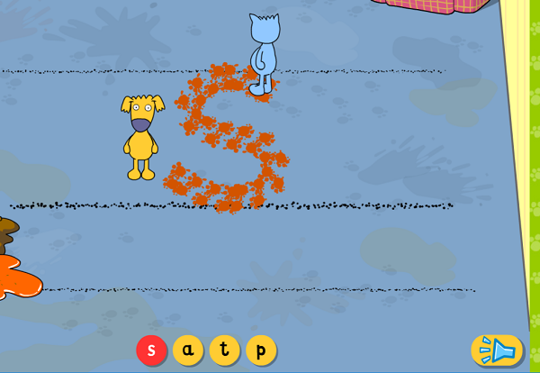
Letter and Word Writing
The messy letters and associated tools within LGfL’s Busy Things (www.busythings.lgfl.net) can support learners in a similar way when using tablets, phones, whiteboards or computers.
www.multisensorylearning.lgfl.net ©2018 www.hirstwood.com & London Grid for Learning

Slide 7
Word and Sentence Building
Hands on tools, such as magnetic letters, and strategies which support learners to physically interact with letters and words, as well as engage with their other senses, as they build them are very effective.
There are many online and offline literacy packs and games that enable children to physically manipulate letters and parts of words and sentences to facilitate literacy.
www.multisensorylearning.lgfl.net ©2018 www.hirstwood.com & London Grid for Learning

Slide 8
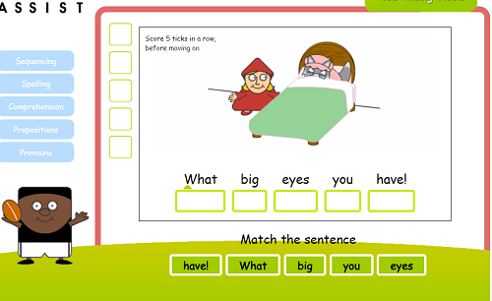
Word and Sentence Building
Strategies such as Colourful Semantics also use vision, sound and movement to support language and grammatical understanding.
LGfL resources that support multisensory word and sentence building include Busy Things and The Fairytales
www.multisensorylearning.lgfl.net ©2018 www.hirstwood.com & London Grid for Learning

Slide 9
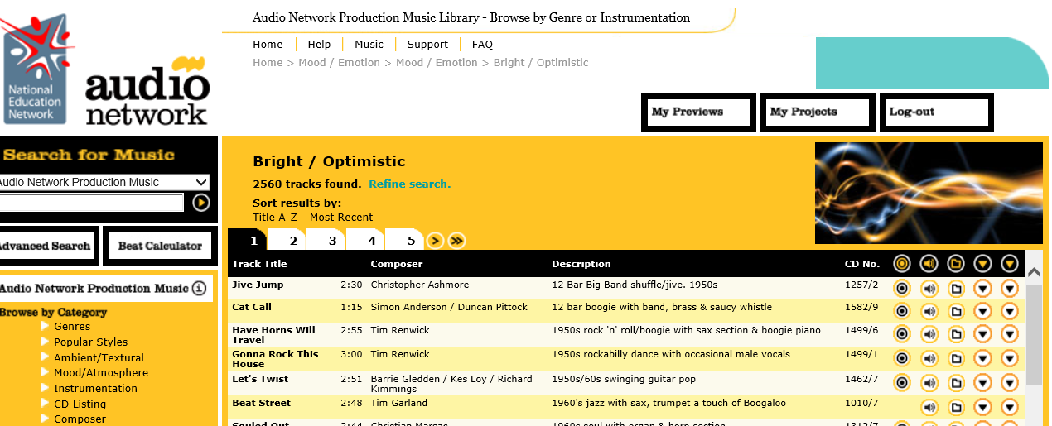
Extended Writing
There are many other multisensory techniques that can be used to support more extended writing. The following LGfL tools can help with this:
Audio Network – www.audio.lgfl.net – thousands of music tracks which can be searched by mood and atmosphere to find music to provide a creative stimulus for writing
www.multisensorylearning.lgfl.net ©2018 www.hirstwood.com & London Grid for Learning

Slide 10
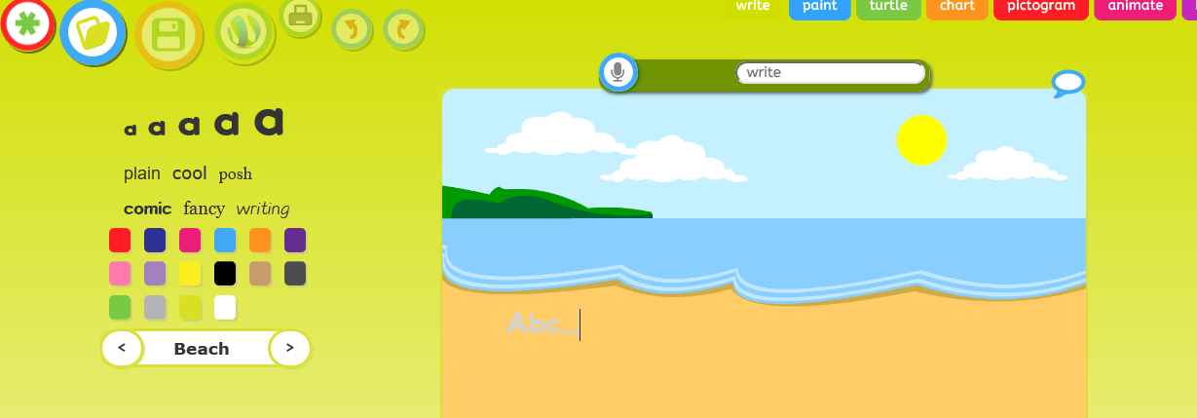
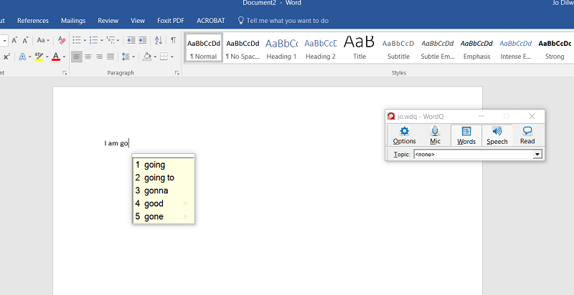
Extended Writing
JiT and J2E – www.j2e.lgfl.net – authoring tools that encourage extended writing using sound, images and more.
WordQ SpeakQ – www.wordq.lgfl.net – assistive technology that includes speech to text to support writing for those with literacy issues.
www.multisensorylearning.lgfl.net ©2018 www.hirstwood.com & London Grid for Learning

Slide 11
Using Visual Stimuli to support Literacy
Using photos, animations, videos or real objects can support a learner’s understanding of a story or piece of writing and can provide a stimulus for writing.
The image bank within the LGfL site may help support understanding.
The LGfL Widgit database includes over 15,000 symbols and associated symbolised activities which can support reading comprehension and extending writing (www.widgit.lgfl.net )
www.multisensorylearning.lgfl.net ©2018 www.hirstwood.com & London Grid for Learning

Slide 12
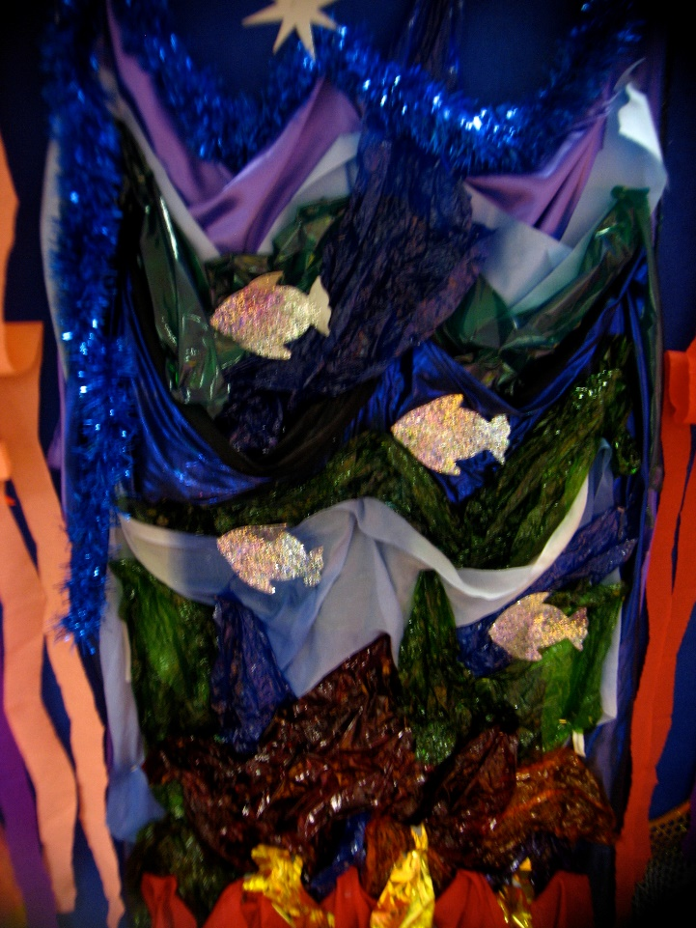
Using Visual Stimuli to support Literacy
Using cameras to help children access and complete a writing activity can also help.
Use multisensory classroom displays or story tents to share visual supports for learners to access a theme
www.multisensorylearning.lgfl.net ©2018 www.hirstwood.com & London Grid for Learning

Slide 13
Using Sound to support Literacy
Singing can help children learn spellings
Tapping out sounds can also support syllabification
Sounding out sounds and words can help with phonics and therefore reading
www.multisensorylearning.lgfl.net ©2018 www.hirstwood.com & London Grid for Learning

Slide 14
Using Sound to support Literacy
Using music can set a scene when approaching story writing (use www.audionetwork.lgfl.net to help)
Using audio books or poems can help to support reading (use www.listeningbooks.lgfl.net to help)
www.multisensorylearning.lgfl.net ©2018 www.hirstwood.com & London Grid for Learning

Slide 15
Using Movement to support Literacy
Staff can help learners use core and motor skills to improve memory, concentration, handwriting and communication skills in a variety of ways.
For example, movement can be used to represent different experiences e.g. how take off might feel for an astronaut (see the Inclusive Resources within Space Adventures at www.sa.lgfl.net for examples).
www.multisensorylearning.lgfl.net ©2018 www.hirstwood.com & London Grid for Learning

Slide 16
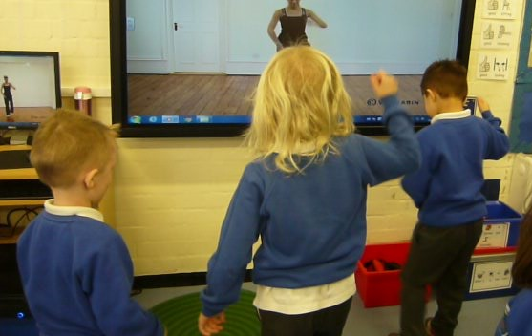
Using Movement to support Literacy
Movement breaks can be used to provide proprioceptive and vestibular input to assist concentration and a resource supporting this will be made available at www.lgfl.net soon
www.multisensorylearning.lgfl.net ©2018 www.hirstwood.com & London Grid for Learning

